Slide 1
SQL Server hybrid cloud
Notes:
Information in this document, including URL and other Internet Web site references, is subject to change without notice. Unless otherwise noted, the example companies, organizations, products, domain names, e-mail addresses, logos, people, places, and events depicted herein are fictitious, and no association with any real company, organization, product, domain name, e-mail address, logo, person, place or event is intended or should be inferred. Complying with all applicable copyright laws is the responsibility of the user. Without limiting the rights under copyright, no part of this document may be reproduced, stored in or introduced into a retrieval system, or transmitted in any form or by any means (electronic, mechanical, photocopying, recording, or otherwise), or for any purpose, without the express written permission of Microsoft Corporation.
Microsoft may have patents, patent applications, trademarks, copyrights, or other intellectual property rights covering subject matter in this document. Except as expressly provided in any written license agreement from Microsoft, the furnishing of this document does not give you any license to these patents, trademarks, copyrights, or other intellectual property.
The names of manufacturers, products, or URLs are provided for informational purposes only and Microsoft makes no representations and warranties, either expressed, implied, or statutory, regarding these manufacturers or the use of the products with any Microsoft technologies. The inclusion of a manufacturer or product does not imply endorsement of Microsoft of the manufacturer or product. Links may be provided to third party sites. Such sites are not under the control of Microsoft and Microsoft is not responsible for the contents of any linked site or any link contained in a linked site, or any changes or updates to such sites. Microsoft is not responsible for webcasting or any other form of transmission received from any linked site. Microsoft is providing these links to you only as a convenience, and the inclusion of any link does not imply endorsement of Microsoft of the site or the products contained therein.
© 2017 Microsoft Corporation. All rights reserved.
Microsoft and the trademarks listed at https://www.microsoft.com/en-us/legal/intellectualproperty/Trademarks/Usage/General.aspx are trademarks of the Microsoft group of companies. All other trademarks are property of their respective owners.

Slide 2
Abstract and learning objectives
Abstract
In this workshop, students will work with a media publishing company to design a hybrid cloud disaster recovery solution. Students will design the solution to handle large spikes in load and harden the security to include encryption of PCI data. Additionally, students will implement an archival strategy to keep databases sizes in check.
Learning objectives
Attendees will be better able to design a hybrid disaster recovery solution between an on premises VMWare environment and Azure. In addition,
Design a SQL Server scale-out solution
Protect database backups from local failures
Archive cold data from an on-premises SQL Server
Perform end-to-end encryption on sensitive application data

Slide 3
Step 1: Review the customer case study
Outcome
Analyze your customer needs
Timeframe
15 minutes

Slide 4
Customer situation
Fabrikam Publishing
Media and publishing company
Approximately 5000 employees
Successful direct-to-consumer e-commerce site
Built using .NET and SQL Server
Data center
Single location hosting all internal and external applications
Virtualized environment running VMWare
Application servers run all Microsoft software
Mostly AD-integrated Internet Information Services web apps
SQL Server 2016 backends where needed
Notes:
Fabrikam Publishing is a media and publishing company in Seattle, Washington, with approximately 5,000 employees. It has a successful direct-to-consumer e-commerce site built with .NET and using SQL Server to store customer profile and order information.
Fabrikam has a single data center for both internal and customer-facing applications. Most servers are virtualized on VMware. Application servers primarily run Microsoft server software, including Active Directory (AD) Domain Services and a number of AD-integrated services, including Exchange 2013, as well as multi-tier, internal, AD-integrated Microsoft Internet Information Services (IIS)–based web applications with SQL Server 2016 as the database platform.

Slide 5
Customer situation
Recent Fabrikam Data Center Outage
Lightning strike disabled cooling systems in data center
Multi-day outage while cooling systems were repaired
Board has approved funding of a disaster recovery site
Cost is still a concern
“A disaster recovery site has been on our project proposals for the last four years, but it has always been shelved due to budget constraints,” says Michelle Jenkins, Chief Information Officer (CIO).
Notes:
Fabrikam’s e-commerce site recently experienced a multi-day outage due to a lightning strike, which disabled both the primary and secondary cooling systems at the data center causing the outage while the cooling systems were repaired.
“A disaster recovery site has been on our project proposals for the last four years, but it has always been shelved due to budget constraints,” says Michelle Jenkins, Chief Information Officer (CIO).
Fabrikam now has board approval for additional funds to build out a new disaster recovery (DR) site. To keep capital expenditures in check, Fabrikam would like to use the public cloud to host its DR site.

Slide 6
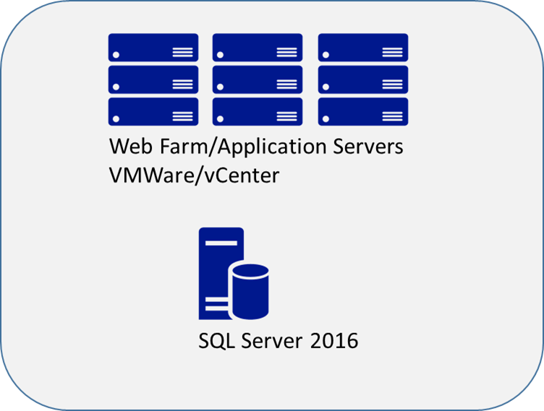
Customer situation
Current Disaster Recovery Strategy
Classic backup/restore
Backups
Dumped to file share
File share is backed up to tape and shipped offsite daily.
No online remote site
No warm standby machines
DR site relies on temporary hardware rented from a hosting facility
Failover has never been tested due to cost and complexity
Notes:
Classic backup/restore
No offsite warm standby machines are available.
Backups are dumped to a file share, which is then backed up to tape and shipped offsite.
No automation, all steps are currently manual.
Disaster site relies on temporary hardware rented from a hosting facility.
Failover has never been tested due to cost and complexity.

Slide 7

Customer situation
Performance concerns
Periodic application performance issues
Heavy read workloads around new product releases
High read latency at the data tier
Maintenance jobs running too long
Large tables
No archival strategy
Notes:
The application periodically experiences high latency at the data tier during periods of high read workloads.
Maintenance jobs are running too long due to large tables with no archive strategy.

Slide 8
Customer situation
Security concerns
PCI and PII data
Requires column level encryption
Requires protection in-flight and at rest
Data should only be accessible by the application
Encryption Key management
Key management is the responsibility of the security team
Automation of key management if possible
Notes:
This database contains both PCI and PII data. Currently the PCI data is encrypted at the column level. They need to prevent the exposure of this data both at rest and in flight.
Encryption key management. The encryption keys need to be managed by the security administrator, not the DBA team. At the same time, they would like to automate as much of the key management as possible.

Slide 9
Customer needs
Multi-site disaster recovery solution
Coverage of both web and data tiers
Minimal complexity with orchestrated failover
Near-zero data loss
Ability to scale DR site infrastructure as the environment grows
Data platform performance solution
Scale-out the read workloads
Minimal impact on write performance
Data encryption solution
Protect data in-flight and at rest
Key management solution to prevent unauthorized persons from gaining access (including DBAs and Developers)
Allows security team to manage key rotation
Notes:
Full, multi-site disaster recovery solution for both the web tier and data tier with minimal complexity, orchestrated failover, and near-zero data loss
Highly available, fault-tolerant SQL Server service with cross-site disaster recovery
The ability to seamlessly scale DR site infrastructure as the environment grows
Scale-out the SQL Server data platform to improve performance of heavy read workloads.
A data encryption solution to protect all PCI data elements in flight and at rest
Key management solution that does not expose the unencrypted keys to unauthorized personnel (including DBAs and Developers) and allows for key rotation by the security administration team.

Slide 10
Customer needs
Data archival solution
Reduce size of the large tables
Reduce the runtimes for maintenance jobs
Allow for access of archived data without changes to existing queries
Backup solution
Backups must be offsite within two hours of backup completion
Backups must be online and accessible by DBA team
Minimize network overhead of the backups
Notes:
Data archiving to keep database sizes more manageable and reduce the amount of time needed for database maintenance
Secure offsite backups in less than two hours

Slide 11
Customer objections
Solution must support orchestrated failover so that failover does not require all hands on deck.
Solution must support the existing VMware infrastructure.
Solution must provide a way to scale out reads on data across multiple SQL Servers.
Solution must not have a negative impact base performance.
DR infrastructure must be easily scalable to support changes in the workload.
Both primary and DR sites must be highly available.
Archive solution must not impact the current applications that periodically pull historical data from the production system.
Backups need to be secure and should minimize network overhead.

Slide 12
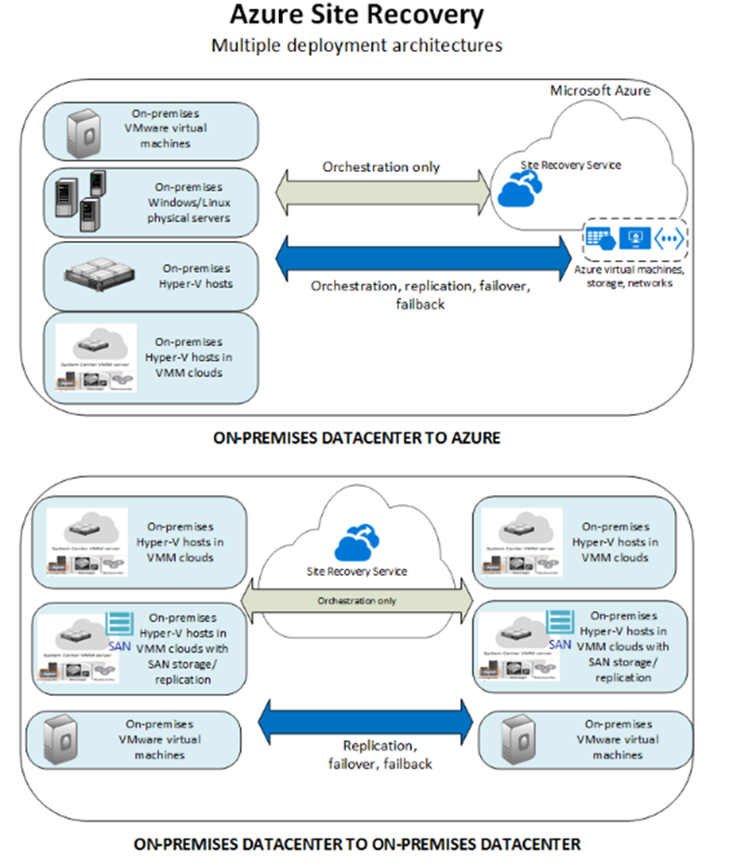
Common scenarios
Azure Site Recovery
Support for on-premises to on-premises, and on-premises to Azure failover
Automated protection and replication of on-premises, Hyper-V, and VMware machines
Orchestrated failover
Customizable recovery plans
Recovery plan testing

Slide 13
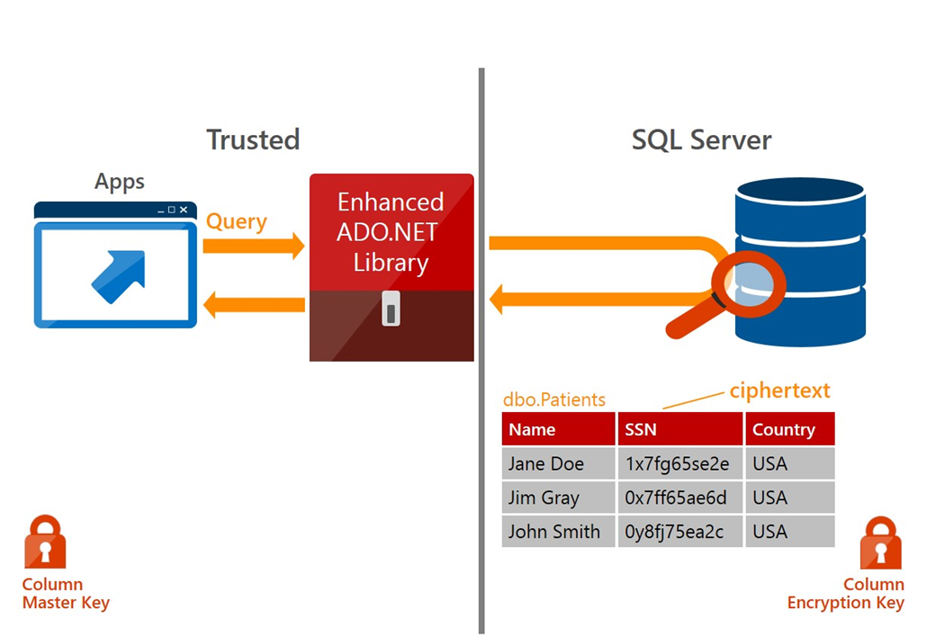
Common scenarios
Always Encrypted
Transparent client side encryption
Equality joins, grouping and indexing on encrypted columns
Separate key management from data management
Minimal application changes

Slide 14
Common scenarios
Stretch Database
Stretch cold tables securely from SQL Server to Azure with remote query processing
Entire table is online and remains accessible from existing apps
No application changes
Addresses hard problems arising from very large tables
Secure by default with optional additional security with Always Encrypted and Row Level Security
Stretch Database
Microsoft Azure
Order history
Name | SSN | Date
Steve Karimi | cm61ba906fd | 2/28/2005
Mike Wan | ox7ff654ae6d | 3/18/2005
Sapna Matuszyk | i2y36cg776rg | 4/10/2005
SQL Mojoe | nx290pldo90l | 4/27/2005
SQL Server
App

Slide 15
Common scenarios
Stretch Database
Stretch cold tables securely from SQL Server to Azure with remote query processing
Entire table is online and remains accessible from existing apps
No application changes
Addresses hard problems arising from very large tables
Secure by default with optional additional security with Always Encrypted and Row Level Security
Stretch Database
Microsoft Azure
Stretch to cloud
Order history
Name | SSN | Date
Steve Karimi | cm61ba906fd | 2/28/2005
Mike Wan | ox7ff654ae6d | 3/18/2005
Sapna Matuszyk | i2y36cg776rg | 4/10/2005
SQL Mojoe | nx290pldo90l | 4/27/2005
Customer data
Product data
Order History
✓
SQL Server
App

Slide 16
Common scenarios
Stretch Database
Stretch cold tables securely from SQL Server to Azure with remote query processing
Entire table is online and remains accessible from existing apps
No application changes
Addresses hard problems arising from very large tables
Secure by default with optional additional security with Always Encrypted and Row Level Security
Stretch Database
Order history
Name | SSN | Date
Steve Karimi | cm61ba906fd | 2/28/2005
Mike Wan | ox7ff654ae6d | 3/18/2005
Sapna Matuszyk | i2y36cg776rg | 4/10/2005
SQL Mojoe | nx290pldo90l | 4/27/2005
Blazej Zwilling | ypo85ba616rj | 5/12/2005
Cheng Jeswani | bns51ra806fd | 5/22/2005
Nikhat Lindell | mci12hh906fj | 6/07/2005
Whitney Lang | utb76b916gi | 6/18/2014
Lorenzo Olds | px61hi9306fj | 7/1/2014
Sophie Cook | ol43bi506gd | 7/12/2014
Aida Durham | tx83hal916fi | 7/29/2014
Jaclyn Wade | nb95re926gi | 8/10/2014
Adrienne Battle | vc61ira536fe | 8/23/2014
Microsoft Azure
SQL Server
App

Slide 17
Common scenarios
Stretch Database
Stretch cold tables securely from SQL Server to Azure with remote query processing
Entire table is online and remains accessible from existing apps
No application changes
Addresses hard problems arising from very large tables
Secure by default with optional additional security with Always Encrypted and Row Level Security
Stretch Database
Order history
Name | SSN | Date
Steve Karimi | cm61ba906fd | 2/28/2005
Mike Wan | ox7ff654ae6d | 3/18/2005
Sapna Matuszyk | i2y36cg776rg | 4/10/2005
SQL Mojoe | nx290pldo90l | 4/27/2005
Blazej Zwilling | ypo85ba616rj | 5/12/2005
Cheng Jeswani | bns51ra806fd | 5/22/2005
Nikhat Lindell | mci12hh906fj | 6/07/2005
Whitney Lang | utb76b916gi | 6/18/2014
Lorenzo Olds | px61hi9306fj | 7/1/2014
Sophie Cook | ol43bi506gd | 7/12/2014
Aida Durham | tx83hal916fi | 7/29/2014
Jaclyn Wade | nb95re926gi | 8/10/2014
Adrienne Battle | vc61ira536fe | 8/23/2014
Microsoft Azure
Query
Query
SQL Server
App

Slide 18
Common scenarios
Stretch Database
Stretch cold tables securely from SQL Server to Azure with remote query processing
Entire table is online and remains accessible from existing apps
No application changes
Addresses hard problems arising from very large tables
Secure by default with optional additional security with Always Encrypted and Row Level Security
Stretch Database
Order history
Name | SSN | Date
Steve Karimi | cm61ba906fd | 2/28/2005
Mike Wan | ox7ff654ae6d | 3/18/2005
Sapna Matuszyk | i2y36cg776rg | 4/10/2005
SQL Mojoe | nx290pldo90l | 4/27/2005
Blazej Zwilling | ypo85ba616rj | 5/12/2005
Cheng Jeswani | bns51ra806fd | 5/22/2005
Nikhat Lindell | mci12hh906fj | 6/07/2005
Whitney Lang | utb76b916gi | 6/18/2014
Lorenzo Olds | px61hi9306fj | 7/1/2014
Sophie Cook | ol43bi506gd | 7/12/2014
Aida Durham | tx83hal916fi | 7/29/2014
Jaclyn Wade | nb95re926gi | 8/10/2014
Adrienne Battle | vc61ira536fe | 8/23/2014
Microsoft Azure
Mike Wan | ox7ff654ae6d | 3/18/2005
Query
Query
SQL Server
App

Slide 19
Common scenarios
Stretch Database
Stretch cold tables securely from SQL Server to Azure with remote query processing
Entire table is online and remains accessible from existing apps
No application changes
Addresses hard problems arising from very large tables
Secure by default with optional additional security with Always Encrypted and Row Level Security
Stretch Database
Order history
Name | SSN | Date
Steve Karimi | cm61ba906fd | 2/28/2005
Mike Wan | ox7ff654ae6d | 3/18/2005
Sapna Matuszyk | i2y36cg776rg | 4/10/2005
SQL Mojoe | nx290pldo90l | 4/27/2005
Blazej Zwilling | ypo85ba616rj | 5/12/2005
Cheng Jeswani | bns51ra806fd | 5/22/2005
Nikhat Lindell | mci12hh906fj | 6/07/2005
Whitney Lang | utb76b916gi | 6/18/2014
Lorenzo Olds | px61hi9306fj | 7/1/2014
Sophie Cook | ol43bi506gd | 7/12/2014
Aida Durham | tx83hal916fi | 7/29/2014
Jaclyn Wade | nb95re926gi | 8/10/2014
Adrienne Battle | vc61ira536fe | 8/23/2014
Microsoft Azure
Mike Wan | ox7ff654ae6d | 3/18/2005
Query
Query
SQL Server
App

Slide 20
Common scenarios
Stretch Database
Stretch cold tables securely from SQL Server to Azure with remote query processing
Entire table is online and remains accessible from existing apps
No application changes
Addresses hard problems arising from very large tables
Secure by default with optional additional security with Always Encrypted and Row Level Security
Stretch Database
Order history
Name | SSN | Date
Steve Karimi | cm61ba906fd | 2/28/2005
Mike Wan | ox7ff654ae6d | 3/18/2005
Sapna Matuszyk | i2y36cg776rg | 4/10/2005
SQL Mojoe | nx290pldo90l | 4/27/2005
Blazej Zwilling | ypo85ba616rj | 5/12/2005
Cheng Jeswani | bns51ra806fd | 5/22/2005
Nikhat Lindell | mci12hh906fj | 6/07/2005
Whitney Lang | utb76b916gi | 6/18/2014
Lorenzo Olds | px61hi9306fj | 7/1/2014
Sophie Cook | ol43bi506gd | 7/12/2014
Aida Durham | tx83hal916fi | 7/29/2014
Jaclyn Wade | nb95re926gi | 8/10/2014
Adrienne Battle | vc61ira536fe | 8/23/2014
Microsoft Azure
Mike Wan | ox7ff654ae6d | 3/18/2005
SQL Server
App

Slide 21
Common scenarios
Backup to URL
Backups direct to private Azure Storage means that backups are offsite immediately.
Geo-redundant storage provides even further protection from regional disasters.
Near limitless storage for backups.
No maintenance costs for backup or storage hardware.
Backup files are available immediately and indefinitely.

Slide 22
Step 2: Design the solution
Outcome
Design a solution and prepare to present the solution to the target customer audience in a 15-minute chalk-talk format.
Timeframe
60 minutes
Business needs (10 minutes) | Respond to questions outlined in your guide and list the answers on a flipchart.
Design (35 minutes) | Design a solution for as many of the stated requirements as time allows. Show the solution on a flipchart.
Prepare (15 minutes) | Identify any customer needs that are not addressed with the proposed solution. Identify the benefits of your solution. Determine how you will respond to the customer’s objections. Prepare for a 15-minute presentation to the customer.

Slide 23
Step 3: Present the solution
Outcome
Present a solution to the target customer in a 15-minute chalk-talk format
Timeframe
30 minutes (15 minutes for each team to present and receive feedback)
Directions
Pair with another table
One table is the Microsoft team and the other table is the customer
The Microsoft team presents their proposed solution to the customer
The customer asks one of the objections from the list of objections in the case study
The Microsoft team responds to the objection
The customer team gives feedback to the Microsoft team

Slide 24
Wrap-up
Outcome
Identify the preferred solution for the case study
Identify solutions designed by other teams
Timeframe
15 minutes

Slide 25
Preferred target audience
Michelle Jenkins, Chief Information Officer
James Sherburn, Director, IT Operations
Robert Moore, Manager, Database Administration
Brandon Burns, Database Architect, Enterprise Architecture

Slide 26
Preferred solution
Overview
Replicate the VMWare environment with Azure Site Recovery (ASR)
Leverage SQL Server AlwaysOn Availability Groups to provide high availability and disaster recovery
Leverage the SQL Server Availability Groups readable secondaries to scale out the heavy read workload.
Using SQL Server Always Encrypted to protect PCI data in-flight or at rest with keys stored in Azure Key Vault
Using SQL Server Stretch Database to archive cold data
Implementing SQL Server Backup to URL to send backups to Azure Storage
Using Azure Traffic Manager with Azure Site Recovery for availability of customer-facing sites
Notes:
Implementing Azure Site Recovery (ASR) to replicate VMware virtual machines to Azure and orchestrate failover in the event of a disaster
Using SQL Server AlwaysOn Availability Groups to provide synchronous high availability on-premises
Using SQL Server AlwaysOn Availability Groups to provide asynchronous disaster recovery in Azure
Leverage SQL Server AlwaysOn Availability Groups with readable secondaries and read-intent routing to offload the heavy read workloads.
Using SQL Server Always Encrypted to encrypt and decrypt PCI data at the application to protect data in-flight or at rest with keys stored in Azure Key Vault.
Using SQL Server Stretch Database to store historical data in Azure SQL Stretch database
Implementing SQL Server Backup to URL to send backups to Azure Storage
Using Azure Traffic Manager with Azure Site Recovery for availability of customer-facing sites
Let us review in more detail.

Slide 27
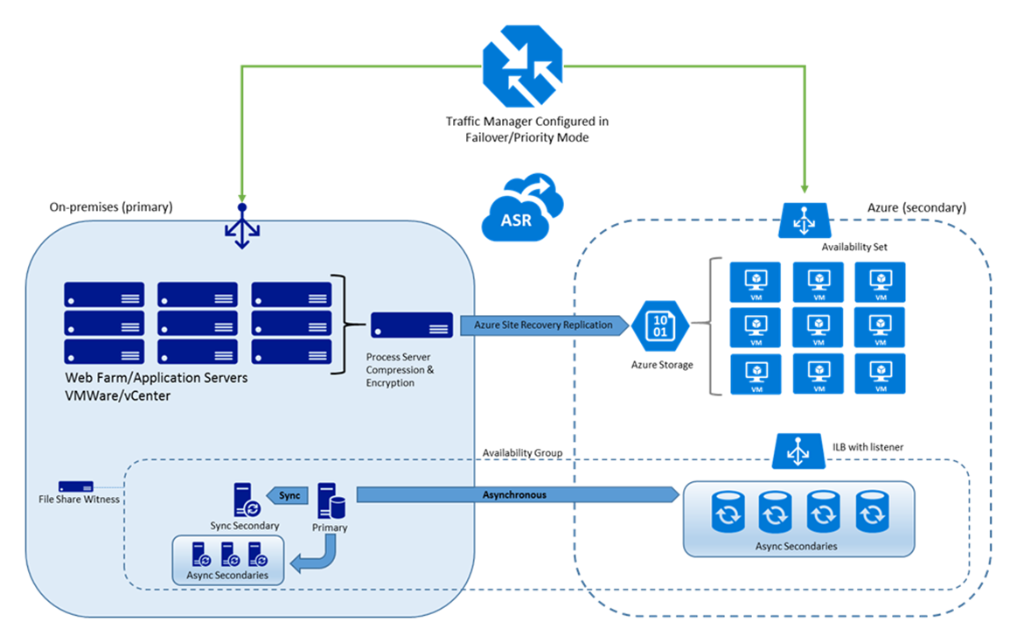
Preferred solution
Azure Site Recovery
Protects web farm
Orchestrates failover
DR machines offline until failover
Replicated data goes straight to VHD
Traffic Manager
Configured in failover mode
Directs clients to the active site
Notes:
Azure Site Recovery will be used to protect the web farm and orchestrate failover of the web farm and the SQL Server in the event of a disaster.
The disaster recovery virtual machines in Azure will remain offline until failover. Replicated data will be sent directly to the VHD files sitting in Azure Storage.
Traffic Manager will be configured on two external endpoints (the existing on-premises site and a site that you will pre-configure in DNS for when ASR fails over). When Traffic Manager detects an outage on the primary on-premises site it will failover DNS resolution to the pre-configured site in Azure.

Slide 28
Preferred solution
SQL Server
Synchronous replicas with automatic failover for local site availability
Asynchronous replicas for remote disaster recovery
Additional resources
Process server (for ASR)
Domain controller (for DR site)
Notes:
The SQL Server databases will be protected by SQL Server AlwaysOn Availability Groups.
For on-premises high availability we will use Synchronous Availability Groups with automatic failover.
The disaster recovery SQL Server virtual machines in Azure will use asynchronous replicas of the availability group.
In addition to the process server on-premises, an Active Directory domain controller would also need to be deployed in Azure to support AlwaysOn.

Slide 29
Preferred solution
Scale out data tier
Multiple asynchronous readable secondaries
Application would use read-intent routing
Potential use of third party solutions for routing and caching functionality
Notes:
Multiple Async readable secondaries would be deployed to the availability group to support scale out of the read workloads.
The application would take advantage of read-intent routing to the secondaries to offload much of the application read workload.
Third party solutions may be leveraged to add additional routing or caching capabilities. (i.e. ScaleArc)

Slide 30

Preferred solution
Protect data
SQL Server Always Encrypted
Client-side encryption
In-flight and at rest encryption
Manage encryption keys
Create keys on a separate secure system.
Store keys in Azure Key Vault.
Rotate keys per organizational policies.
Column master key rotation does not re-encrypt the data.
Column encryption key rotation does re-encrypt the data and prevents application writes during re-encryption.
Encryption types
Deterministic: point lookups, equality joins, grouping, indexing
Random: more secure, no lookups, joins, grouping etc.
Notes:
Use SQL Server Always Encrypted to implement client-side encryption and protect data in flight and at rest
Manage encryption keys
Create keys on a separate secure system.
Store keys in Azure Key Vault.
Rotate keys per organizational policies.
Column master key rotation does not re-encrypt the data.
Column encryption key rotation does re-encrypt the data and prevents application writes during re-encryption.
Application impact should be minimal. Code will need to be updated to pull keys from Azure Key Vault. Client drivers may need to be updated.
Choose the correct encryption type for each data element.
Deterministic allows point lookups, equality joins, grouping and indexing
Random is more secure but does not allow point lookups, equality joins, grouping and indexing

Slide 31
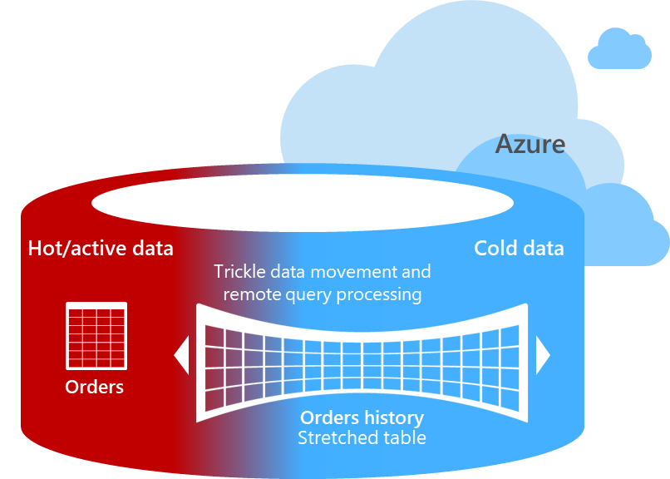
Preferred solution
Data archive
SQL Server Stretch Database
Archive cold data to Azure
Cold data is still online
No query changes
Identifying Stretch Database candidates
What is the retention period of the data?
How often is the cold data accessed?
Will the cold data need to be modified or is it immutable?
Is cold/historical data stored in dedicated tables or mixed with hot data?
Stretch Database Advisor
Maintenance experience may improve significantly
Notes:
Use SQL Server Stretch Database to migrate historical data transparently and securely to Azure
Ask the following questions before implementing a cold data solution
What is the retention period of the data?
How often is the cold data accessed?
Will the cold data need to be modified or is it immutable?
Is cold/historical data stored in dedicated tables or mixed with hot data?
Use the Stretch Database Advisor to identify tables for Stretch Database and flag any blocking issues
Stretch Database will not require any changes to the existing applications but queries that touch historical data will have higher latency
Maintenance experience may improve significantly
Most maintenance only affects local data

Slide 32
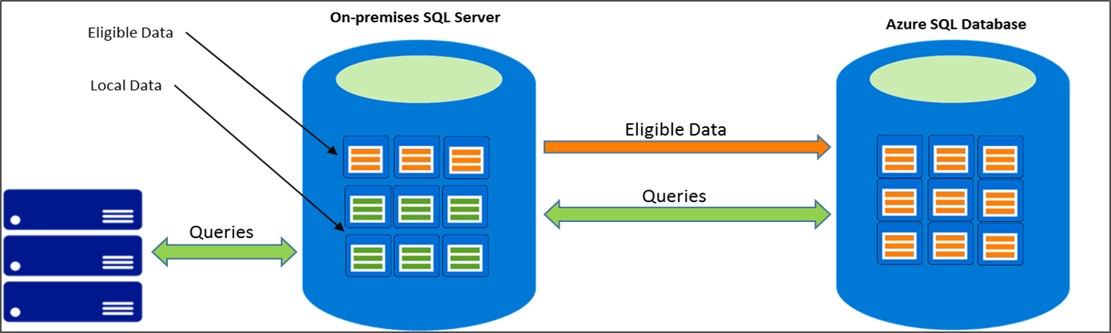
Preferred solution
What impact will your design have on the existing reporting system?
The existing reporting system will not need any modifications after implementing Stretch Database.
Queries that include Stretch-enabled tables are expected to perform more slowly than they did before the tables were enabled for Stretch.
How will this solution effect the current maintenance issues?
By migrating a large portion of the data into Azure, the regular maintenance should improve dramatically. Backups will only back up local data and index maintenance will have a significantly smaller data set to work with.
Notes:
What impact will your design have on the existing reporting system?
The existing reporting system will not need any modifications after implementing Stretch Database.
Queries that include Stretch-enabled tables are expected to perform more slowly than they did before the tables were enabled for Stretch.
How will this solution effect the current maintenance issues?
By migrating a large portion of the data into Azure SQL Database, the regular maintenance should improve dramatically. Backups will only back up and index maintenance will have a significantly smaller data set to work with.

Slide 33
Preferred solution
Offsite backup
SQL Server backup to URL
Performs backups directly to Azure Storage.
Storage accounts protected with access keys
Using the WITH ENCRYPTION option in the backup command further secures the backup from unauthorized backup.
Geo-redundancy in Azure Storage asynchronously copies the backup files to a second region.
Backup compression can minimize network overhead and optimize backup performance across a WAN.
Notes:
SQL Server Backup to URL provides the most straightforward replacement of the existing backup solution.
SQL Server Backup to URL uses an Azure Storage in your subscription to perform an offsite backup.
Azure Storage access control prevents unauthorized access by requiring a key to access the storage account.
Using the WITH ENCRYPTION option in the backup command further secures the backup from unauthorized backup.
Geo-redundancy in Azure Storage asynchronously copies the backup files to a second region.
Managing Azure Storage Account performance targets can be managed by spreading multiple databases’ backups across multiple storage accounts.

Slide 34
Preferred objections handling
Objection
Solution must support orchestrated failover so that failover does not require all hands on deck.
Potential answer
Azure Site Recovery orchestrates replication of your on-premises and virtual machines to a secondary on-premises data center or to Azure. Site recovery handles the VM replication and integrates with SQL Server Availability Groups. Failover can be kicked off with a simple click.

Slide 35
Preferred objections handling
Objection
Solution must support the existing VMware infrastructure.
Potential answer
Azure Site Recovery supports the replication of on-premises servers, Azure virtual machines, Hyper-V virtual machines, and VMware virtual machines.

Slide 36
Preferred objections handling
Objection
Solution must not have a significant impact on database performance.
Potential answer
The use of asynchronous replicas to the disaster recovery site will keep the overhead of Availability Group replication to near zero while providing the application the ability to offload the heavier read workloads to the secondary replicas.
Notes:
While leveraging synchronous Availability Groups for high availability will have an impact on write performance, the overall benefit of the read scale-out will outweigh any negative impact on the write workload. People always want to argue about this. The fact is that even on a database that is considered a heavy write workload, most of the io is still dominated by reads (unless you are talking about special cases like loading data, or writing to heaps and never issuing a read). Most OLTP systems have some amount of dedicated read going on. In this case the customer has specifically stated that their analysis shows that a heavy READ workload is causing performance issues. Obviously this could be something simple like an indexing problem but the customer has also specifically asked about a scale-out solution. If someone is concerned about a solution requiring more licensing, note that scaling a single server up to handle the read workload may not be enough, also that hardware cost goes up exponentially with performance (or at least it is not linear) and that you are already leveraging availability groups.

Slide 37
Preferred objections handling
Objection
Disaster recovery infrastructure must be easily scalable to support changes in the workload.
Potential answer
As workloads change, Azure virtual machines may be scaled up or down as necessary to provide the appropriate amount of resources. This can be done by modifying the virtual machine size.

Slide 38
Preferred objections handling
Objection
The disaster recovery sites must be highly available after a failover.
Potential answer
By placing Azure virtual machines into an Availability Set, you can keep your virtual machines available during downtime, such as during maintenance or unplanned outages. It is a best practice to use availability sets and load-balancing endpoints to help ensure that your application is always available and running efficiently.
SQL Server virtual machines will rely on a combination of Availability Sets and SQL Server Availability Groups to maintain uptime and synchronization. The SQL Servers will belong to a separate Availability Set from the web servers and will also use an internal load balancer.

Slide 39
Preferred objections handling
Objection
Archive solution must not impact the current applications that periodically pull historical data from the production system.
Potential answer
SQL Server Stretch Database does not require any changes to existing queries or applications, the location of the data is completely transparent to the application. The entire table is always online and can be queried. You will set the policy that determines where the data is stored either on the local server or in Azure.

Slide 40
Preferred objections handling
Objection
Backups need to be secured offsite in less than two hours after completion.
Potential answer
SQL Server Backup to URL backs up databases directly to Azure Storage. As soon as the backup is complete, it is offsite and protected. Furthermore, if using geo-redundant storage, your database backups will be asynchronously replicated to a secondary region hundreds of miles away.

Slide 41
Customer quote
“By using Azure, we have the confidence that we can keep our business running in the event of a disaster, with minimal overhead and near-zero data loss”
—Michelle Jenkins, Chief Information Officer, Fabrikam Publishing

